Slide 1
Network Fundamentals for Cloud
Nishit Narang
WILPD-CSIS

Slide 2
CC ZG503: Network Fundamentals for Cloud
Lecture No. 7: SDN and NFV

Slide 3
Software Defined Networking (SDN)
Some Slides Taken and Adapted from:
Computer Networking: A Top-Down Approach, 8th edition, Jim Kurose, Keith Ross, Pearson, 2020
All material copyright 1996-2020
J.F Kurose and K.W. Ross, All Rights Reserved

Slide 4
Network layer: data plane, control plane
Data plane:
local, per-router function
determines how datagram arriving on router input port is forwarded to router output port
Control plane
network-wide logic
determines how datagram is routed among routers along end-end path from source host to destination host
values in arriving
packet header
two control-plane approaches:
traditional routing algorithms: implemented in routers
software-defined networking (SDN): implemented in (remote) servers
0111
1
3
2

Slide 5

Per-router control plane
Individual routing algorithm components in each and every router interact in the control plane
Routing
Algorithm
control
plane
data
plane
values in arriving
packet header
0111
1
3
2

Slide 6
Software-Defined Networking (SDN) control plane
Remote controller computes, installs forwarding tables in routers
Remote Controller
control
plane
data
plane
CA
values in arriving
packet header
CA
CA
CA
CA
0111
1
3
2

Slide 7
Lets Look into…,
Traditional Switch Architecture
Evolution of Switches, Control Planes and needs of Modern Data Centers

Slide 8
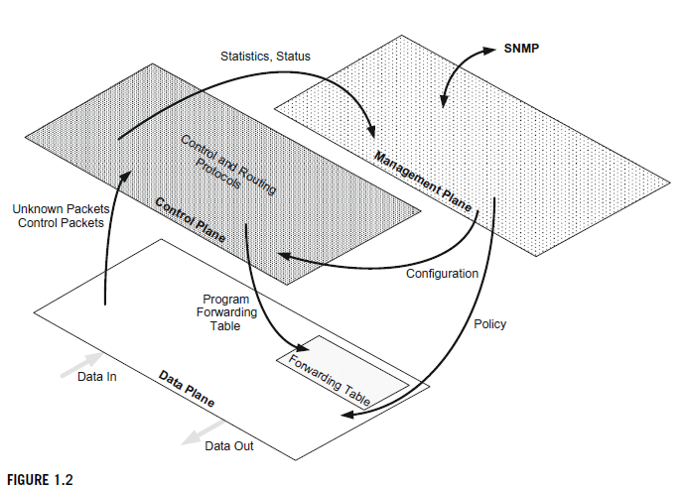
Evolution of Switches and Control Planes
Traditional Switch Architecture
Data Plane
Vast majority of packets only touch data plan
Contains
Reception & Transmission Ports
Forwarding Table
What does the Data Plane do?
Packet buffering
Packet scheduling
Header modification and forwarding
What happens if the packet information is not in the forwarding table?
Data Plane communicates vertically to Control Plane

Slide 9
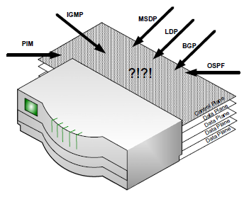
Evolution of Switches and Control Planes
Traditional Switch Architecture
Control Plane
Principal role - Keep forwarding table up-to-date
Control plane of the switch is bombarded with a constant barrage of control protocol traffic
Process control protocols - Control protocols collectively manage the topology of the network.
Management Plane
Network administrators configure and monitor the switch through this plane
Interfaces vertically to collect or update information in other planes
Typically a NMS (network management system) communicates to the plane in the switch.

Slide 10
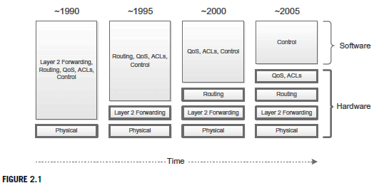
Evolution of Switches and Control Planes
Developers → implemented distributed environment with intelligence in each device
Coordination between devices → Collective decisions
Goals
Simplicity
Ease of use
Automatic Recovery
Distributed Intelligence in L2 and L3
Spanning Tree Protocol (STP) – IEEE 802.1D
Enforces a hierarchy on the network, Convergence latency
Rapid Spanning Tree Protocol (RSTP) – IEEE 802.1D-2004
Improves latency, but not deployed
Shortest Path Bridging (SPB)
RIP, BGP, OSPF, and IS-IS
Layer 3 requires the cooperation between devices, Knowledge of which routers are attaching to which subnets in a network.

Slide 11
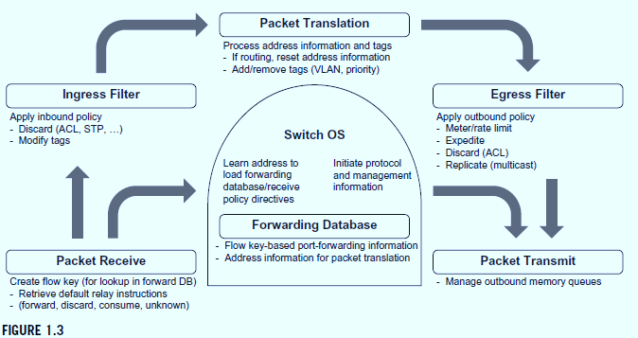
Evolution of Switches and Control Planes
Software-Based Routing and Bridging
Ethernet interface speed increased through the 90’s.
Hardware solutions leveraged to help routers and bridges keep up with increasing speed
Eventually software could not keep up with header inspection and routing table lookups
Generically Programmable Forwarding Rules
Early routers – limited packet header field mods.
Switch features grew over time
Multi-cast, VLANs, MPLS, etc.
Pushing programmable rules to the hardware allows complex manipulation while maintaining line rates
This Programmable hardware gives life to the “concept of SDN”

Slide 12
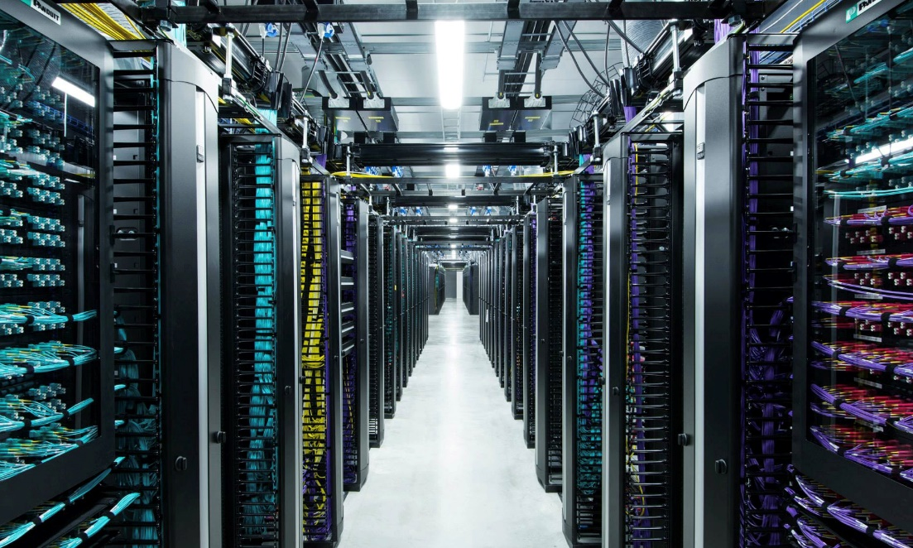
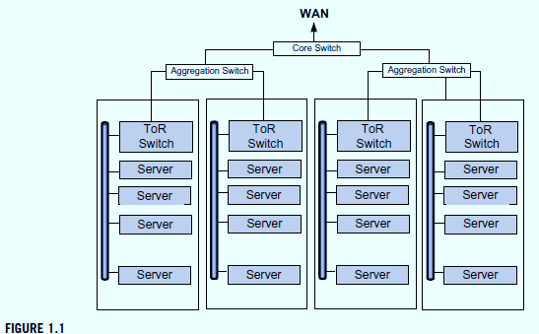
Modern Data Center
Modern Data Center
WWW leads to
Large data centers with huge numbers of servers and even greater VMs
Protocols designed to provide robustness over geographic area not appropriate for the huge amount of traffic in the DC
Routers spend 30% of CPU cycles in rediscovery and recalculating routes
East / West traffic doesn’t benefit from overhead of protocols.
SDN was designed to handle the network of the modern data center → fundamental shift from traditional Internet switching

Slide 13
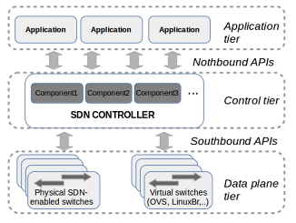
SDN Architecture
SDN general
Architecture

Slide 14
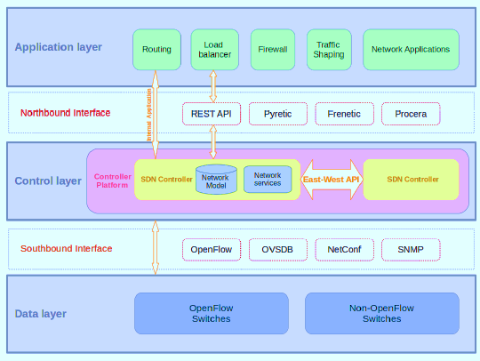
SDN Architecture
A three-layer
distributed
SDN Architecture

Slide 16
Generalized forwarding: match plus action
Review: each router contains a forwarding table
“match plus action” abstraction: match bits in arriving packet, take action
(aka: flow table)
destination-based forwarding: forward based on dest. IP address
values in arriving
packet header
generalized forwarding:
many header fields can determine action
many action possible: drop/copy/modify/log packet
0111
1
3
2
forwarding table
(aka: flow table)

Slide 17
Flow table abstraction
flow: defined by header field values (in link-, network-, transport-layer fields)
generalized forwarding: simple packet-handling rules
match: pattern values in packet header fields
actions: for matched packet: drop, forward, modify, matched packet or send matched packet to controller
priority: disambiguate overlapping patterns
counters: #bytes and #packets
Flow table
Router’s flow table define router’s match+action rules
match
action

Slide 18
Flow table abstraction
flow: defined by header fields
generalized forwarding: simple packet-handling rules
match: pattern values in packet header fields
actions: for matched packet: drop, forward, modify, matched packet or send matched packet to controller
priority: disambiguate overlapping patterns
counters: #bytes and #packets
Flow table
src = *.*.*.*, dest=3.4.*.* forward(2)
match
action
src=1.2.*.*, dest=*.*.*.* drop
src=10.1.2.3, dest=*.*.*.* send to controller
* : wildcard
1
4
3
2

Slide 19
OpenFlow: flow table entries
Match
Action
Stats
Packet + byte counters
Forward packet to port(s)
Drop packet
Modify fields in header(s)
Encapsulate and forward to controller
Header fields to match:
Ingress Port
Src MAC
Dst MAC
Eth Type
VLAN
ID
VLAN
Pri
IP Src
IP Dst
IP Proto
IP
ToS
TCP/UDP Src Port
TCP/UDP Dst Port
Link layer
Network layer
Transport layer

Slide 20
OpenFlow: examples
Destination-based forwarding:
Switch
Port
MAC
src
MAC
dst
Eth
type
VLAN
ID
VLAN
Pri
IP
Src
IP
Dst
IP
Prot
IP
ToS
TCP
s-port
TCP
d-port
Action
*
*
*
*
*
*
*
51.6.0.8
*
*
*
*
port6
IP datagrams destined to IP address 51.6.0.8 should be forwarded to router output port 6
Firewall:
Switch
Port
MAC
src
MAC
dst
Eth
type
VLAN
ID
VLAN
Pri
IP
Src
IP
Dst
IP
Prot
IP
ToS
TCP
s-port
TCP
d-port
Action
*
*
*
*
*
*
*
*
*
*
*
22
drop
Block (do not forward) all datagrams destined to TCP port 22 (ssh port #)
Switch
Port
MAC
src
MAC
dst
Eth
type
VLAN
ID
VLAN
Pri
IP
Src
IP
Dst
IP
Prot
IP
ToS
TCP
s-port
TCP
d-port
Action
*
*
*
*
*
*
128.119.1.1
*
*
*
*
*
drop
Block (do not forward) all datagrams sent by host 128.119.1.1

Slide 21
OpenFlow: examples
Layer 2 destination-based forwarding:
Switch
Port
MAC
src
MAC
dst
Eth
type
VLAN
ID
VLAN
Pri
IP
Src
IP
Dst
IP
Prot
IP
ToS
TCP
s-port
TCP
d-port
Action
*
*
22:A7:23:
11:E1:02
*
*
*
*
*
*
*
*
*
port3
layer 2 frames with destination MAC address 22:A7:23:11:E1:02 should be forwarded to output port 3

Slide 22
OpenFlow abstraction
match+action: abstraction unifies different kinds of devices
Router
match: longest destination IP prefix
action: forward out a link
Switch
match: destination MAC address
action: forward or flood
Firewall
match: IP addresses and TCP/UDP port numbers
action: permit or deny
NAT
match: IP address and port
action: rewrite address and port

Slide 23


OpenFlow example
Host h6
10.3.0.6
Orchestrated tables can create network-wide behavior, e.g.,:
datagrams from hosts h5 and h6 should be sent to h3 or h4, via s1 and from there to s2
1
s3
controller
2
3
4
Host h5
10.3.0.5
1
s1
1
s2
Host h1
10.1.0.1
2
4
Host h4
10.2.0.4
4
2
3
3
Host h2
10.1.0.2
Host h3
10.2.0.3

Slide 24
OpenFlow example
match
action
Orchestrated tables can create network-wide behavior, e.g.,:
datagrams from hosts h5 and h6 should be sent to h3 or h4, via s1 and from there to s2
IP Src = 10.3.*.*
IP Dst = 10.2.*.*
forward(3)
Host h6
10.3.0.6
1
s3
controller
2
3
4
Host h5
10.3.0.5
1
s1
1
s2
Host h1
10.1.0.1
2
4
Host h4
10.2.0.4
4
2
3
3
match
action
match
action
Host h2
10.1.0.2
Host h3
10.2.0.3
ingress port = 2
IP Dst = 10.2.0.3
ingress port = 2
IP Dst = 10.2.0.4
ingress port = 1
IP Src = 10.3.*.*
IP Dst = 10.2.*.*
forward(3)
forward(4)
forward(4)

Slide 25
Generalized forwarding: summary
“match plus action” abstraction: match bits in arriving packet header(s) in any layers, take action
matching over many fields (link-, network-, transport-layer)
local actions: drop, forward, modify, or send matched packet to controller
“program” network-wide behaviors
simple form of “network programmability”
programmable, per-packet “processing”
historical roots: active networking
today: more generalized programming

Slide 26
Network Function Virtualization (NFV)
Some Slides Taken and Adapted from:
Computer Networking: A Top-Down Approach, 8th edition, Jim Kurose, Keith Ross, Pearson, 2020
All material copyright 1996-2020
J.F Kurose and K.W. Ross, All Rights Reserved

Slide 27
Virtualization Concept

Slide 28
Network Virtualization
What is network virtualization ?
In computing, Network Virtualization is the process of combining hardware and software network resources and network functionality into a single, software-based administrative entity, a virtual network.
Two categories :
External network virtualization
Combining many networks, or parts of networks, into a virtual unit.
Internal network virtualization
Providing network-like functionality to the software containers on a single system.

Slide 29
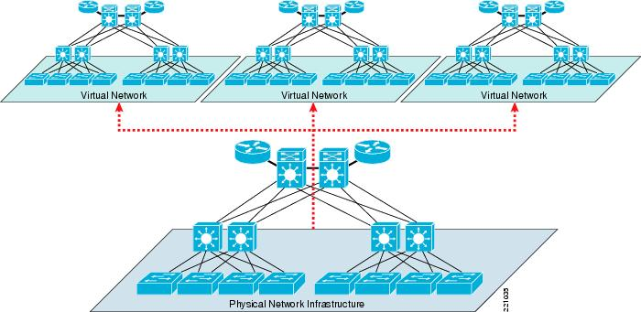
Network Virtualization
What is network virtualization ?

Slide 30
Network Virtualization
Desirable properties of network virtualization :
Scalability
Easy to extend resources in need
Administrator can dynamically create or delete virtual network connection
Resilience
Recover from the failures
Virtual network will automatically redirect packets by redundant links
Security
Increased path isolation and user segmentation
Virtual network should work with firewall software
Availability
Access network resource anytime

Slide 31
Network Virtualization
External network virtualization in different layers :
Layer 1
Seldomly implemented in physical data transmission layer.
Layer 2
Use some tags in MAC address packet to provide virtualization.
Example, VLAN.
Layer 3
Use some tunnel techniques to form a virtual network.
Example, VPN.
Layer 4 or higher
Build up some overlay network for some application.
Example, P2P.

Slide 32
Network Virtualization
Internal network virtualization in different layers :
Layer 1
Hypervisor usually do not need to emulate the physical layer.
Layer 2
Implement virtual L2 network devices, such as switch, in hypervisor.
Layer 3
Implement virtual L3 network devices, such as router, in hypervisor.
Layer 4 or higher
Layer 4 or higher layers virtualization is usually implemented in guest OS.

